Slide 1
Doxygen

Slide 2
Doxygen: Generate documents from comments
$ sudo apt update
$ sudo apt install -y doxygen graphviz
Create Doxyfile by
$ doxygen -g
Open this file and edit

Slide 3
Edit Doxyfile
PROJECT_NAME = “Book renting”
EXTRACT_ALL = YES
GENERATE_LATEX = NO
INPUT = "./"
INPUT += "../lib"
RECURSIVE = YES
HTML_OUTPUT = docs

Slide 4
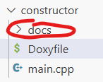
Running doxygen
$ doxygen Doxyfile

Slide 5
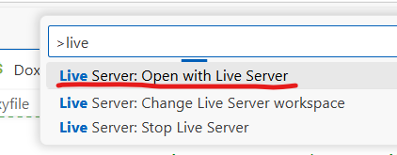
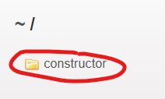
Viewing documents
Extension: Live server.
2. Open file docs > index.html
3. Ctrl + Shift + P >

Slide 6
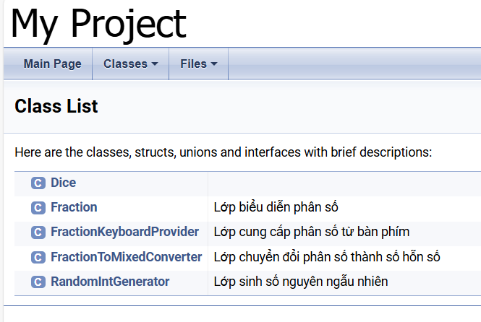
What to expect?

